Slide 1
Ch03_Process Concepts

Slide 2
Contents
01_Introduction
02_Process States: Life Cycle of a Process
03_Process Management
04_Interrupts
05_Interprocess Communication
06_Case Study: UNIX Processes
Objectives - you should understand:
• the concept of a process.
• the process life cycle.
• process states and state transitions.
• process control blocks (PCBs)/process descriptors.
• how processors transition between processes via context switching.
• how interrupts enable hardware to communicate with software.
• how processes converse with one another via interprocess communication(IPC).
• UNIX processes.

Slide 3
01_Introduction (1/2)
Computer performs multiple actions at the same time
For example, compiling a program, sending a file to a printer, rendering a Web page, playing a digital video clip and receiving e-mail concurrently
Process - performs and keeps track of many simultaneous activities
Process - makes transitions between process states.
Operating system - performs to service processes, such as creating, destroying, suspending, resuming and waking up processes

Slide 4
01_Introduction (2/2)
Definition of Process
Program in execution (= active entity)
Process has its own address space
Text region
Stores the code that the processor executes
Data region
Stores variables and dynamically allocated memory that the process uses during execution.
Stack region
Stores instructions and local variables for active procedure calls

Slide 5
02_Process States : Life Cycle of a Process
Process states
Running state - Process is executing on a processor
Ready state – Process can execute on a processor if it is available
Block state
Process is waiting for some event to happen before it can proceed
During its lifetime, a process moves through a series of discrete process states
Ready list & Blocked list
Ready list – list of ready processes
Is maintained in priority order
The next process to receive a processor is the first one in the list
Blocked list – list of blocked processes
Unblock in the order in which the events they are waiting for occur

Slide 6
03_Process Management (1/12)
Operating system provides fundamental services to processes
Creating processes
Destroying processes
Suspending processes
Resuming processes
Changing a process's priority
Blocking processes
Waking up processes
Dispatching processes
Inter-Process Communication (IPC)
Enable a process to communicate with another process

Slide 7
03_Process Management (2/12)
Process States and State Transition
Process state – Ready, Running, Block
Dispatching – The act of assigning a processor to the first process on the ready list by dispatcher
Operating System
Manages state transitions to best serve processes in the system
Prevent any one process from monopolizing the system, either accidentally or maliciously
Allow a process to run for a specific time interval or quantum
Use a hardware interrupting clock (an interval timer)
State transitions
Four possible state transitions (Figure 3.1)
Ready to Running - A processor is assigned to the process
Running to Ready - A process’s quantum expires
Running to Blocked - A process blocked
Blocked to Ready – A process wakes up

Slide 8
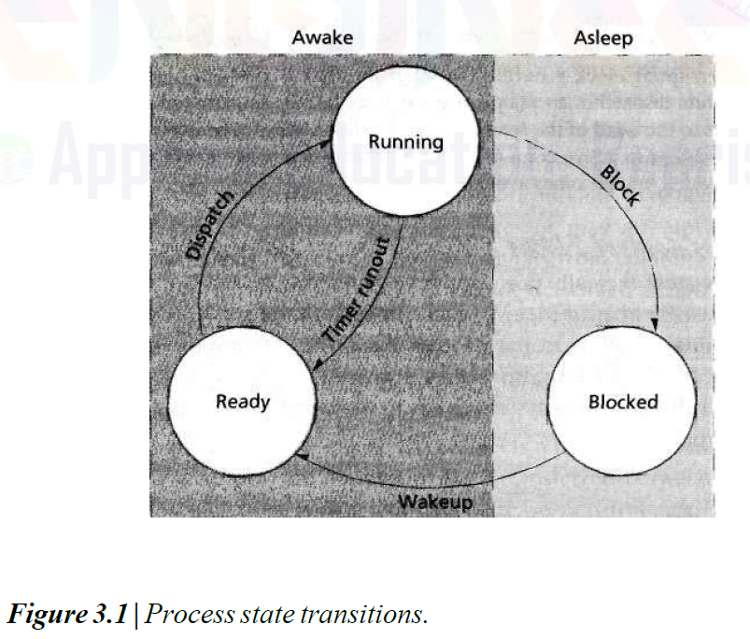
03_Process Management (3/12)
Process States and State Transition

Slide 9
03_Process Management (4/12)
Process Control Blocks (PCBs)/Process Descriptors
Maintains information that the operating system needs to manage the process
PID (Process Identification)
Process state (e.g., running, ready or blocked)
Program counter (i.e., a value that determines which instruction the processor should execute next)
Scheduling priority
Credentials (i.e., data that determines the resources this process can access)
A pointer to the process's parent process (i.e., the process that created this
process)
Pointers to the process's child processes (i.e., processes created by this process) if any
Pointers to locate the process's data and instructions in memory
Pointers to allocated resources (such as files)

Slide 10
03_Process Management (5/12)
Process Control Blocks (PCBs)/Process Descriptors
Process table (Fig. 3.2)
Operating system maintains pointers to each process's PCB in a systemwide or per-user process table so that it can access the PCB quickly
When a process is terminated (either voluntarily or by the operating system), the operating system
Frees the process's memory and other resources
Removes the process from the process table
Makes its memory and other resources available to other processes

Slide 11
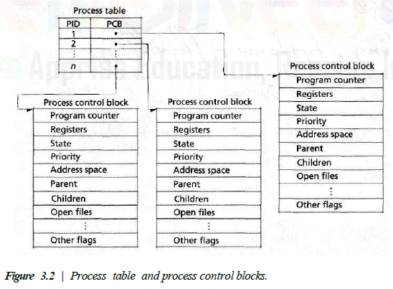
03_Process Management (6/12)
Process Control Blocks (PCBs)/Process Descriptors

Slide 12
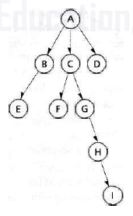
03_Process Management (7/12)
Process Operations
A process spawn a new process
Parent process
The creating process
Child process
The created process
Each child process is created by exactly
one parent process
Destruction of a process (One of next two cases)
Each spawned process is destroyed automatically
when its parent is destroyed
Spawned processes proceed independently of
their parents, and the destruction of a parent
has no effect on its children

Slide 13
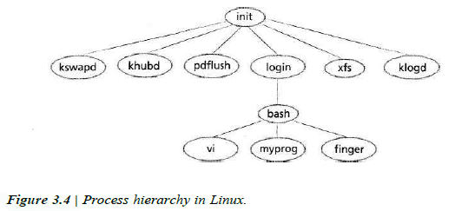
03_Process Management (8/12)
Process Operations

Slide 14
03_Process Management (9/12)
Suspend and Resume
A suspended process
Indefinitely removed from contention for a processor without being destroyed
Useful for detecting security threats (such as malicious code execution) and for software debugging purposes
A suspension may be initiated by the process being suspended or by another process
A suspended states
Suspendedready
Suspendedblocked
A suspendedblocked process may be resumed by another process

Slide 15
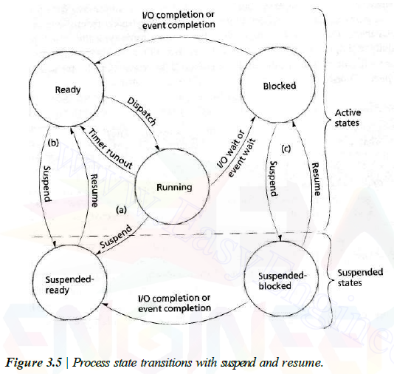
03_Process Management (10/12)
Suspend and Resume

Slide 16
03_Process Management (11/12)
Context switches
Stop executing a running process and begin executing a previously ready process
Save the execution context of the running process to its PCB
Load the ready process's previous execution context from its PCB
Must be essentially transparent to processes
meaning that the processes are unaware they have been removed from the processor
During a context switch, a processor cannot perform any "useful" computation
Operating systems must minimize context-switching time
Context: General Purpose Register, Program Counter, Stack Pointer, Process State Register,
Memory Management Information(Page Table, Page Directory, Memory Allocation State)

Slide 17
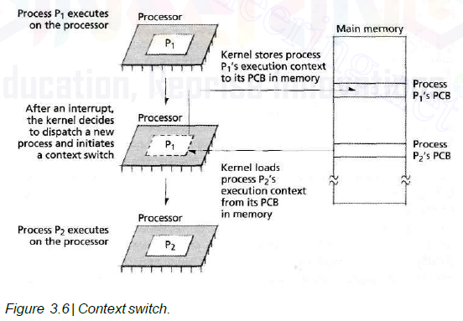
03_Process Management (12/12)
Context switches
①
③
②
④
⑤

Slide 18
04_Interupts (1/6)
Interrupts
Interrupts enable software to respond to signals from hardware
A processor generates an interrupt as a result of executing a process's current instructions
Synchronous with the operation of the process (=Synchronous interrupt)
Ex.) such as dividing by zero or referencing a protected memory location
Interrupts may also be caused by some event that is unrelated to a process's current instruction
Asynchronous with process execution (=Asynchronous interrupt)
Ex.) a user presses a key in keyboard or moves mouse
Low-overhead to Processor
Polling
An alternative to interrupts
A processor repeatedly requests the status of each device
Increases overhead as the complexity of the computer system increases

Slide 19
04_Interupts (2/6)
Interrupt Processing
How process hardware interrupts?
An interrupt controller orders interrupts according to their priority
The processor completes execution of the current instruction, then pauses the execution of the current process
The processor passes control to the appropriate interrupt handler
The interrupt handler performs appropriate actions based on the type of interrupt
After the interrupt handler completes, the state of the interrupted process is restored
The interrupted process (or some other "next process") executes

Slide 20
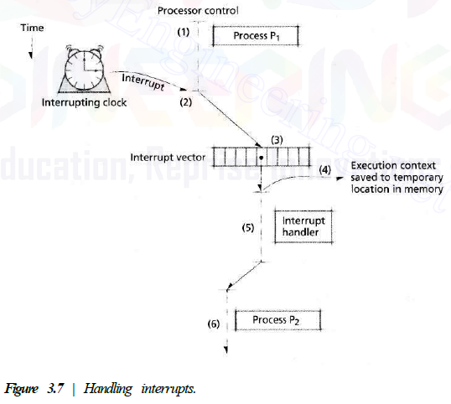
04_Interupts (3/6)
Interrupt Processing
How the operating system and hardware interact in response to clock interrupts
Process Scheduler picked P₂

Slide 21
04_Interupts (4/6)
Interrupt Classes
The set of interrupts a computer supports is dependent on the system's architecture
The Intel IA-32 specification distinguishes between two types of signals a processor may receive
Interrupts
An event has occurred (e.g., a timer interval has passed)
An external device's status has changed (e.g., an I/O completion)
Software-generated interrupts (e.g., system calls)
Exceptions
An error has occurred, either in hardware or as a result of a software instruction
Fault, Trap, Abort
☞ IA-32 specification is implemented in Intel Pentium processors

Slide 22
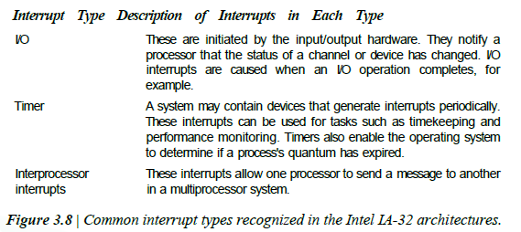
04_Interupts (5/6)
Interrupt Classes

Slide 23
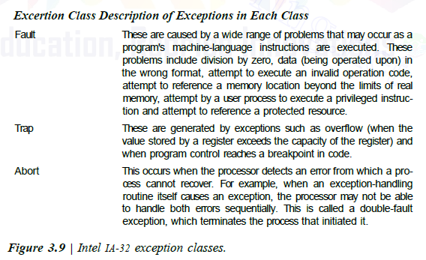
04_Interupts (6/6)
Interrupt Classes

Slide 24
05_Interprocess communication (1/4)
Many operating systems provide mechanisms for interprocess communication (IPC)
In multiprogrammed and networked environments
For example,
A text editor to send a document to a print spooler
A Web browser to retrieve data from a distant server
Coordinate activities to achieve a common goal

Slide 25
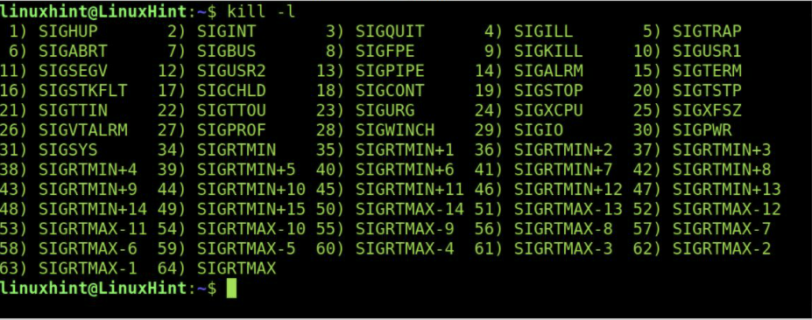
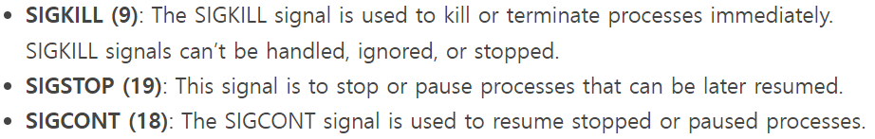
05_Interprocess communication (2/4)
Signals
Software interrupts that notify a process that an event has occurred
Do not allow processes to specify data to exchange with other processes
Catch, Ignore, Masking
A process catches a signal by specifying a routine that the operating system calls when it delivers the signal
A process may also ignore the signal relying on the operating system's default action(e.g., abort, memory dump, suspend) to handle the signal
A process blocks a signal by masking it
When a process masks a signal of a specific type (e.g., the suspend signal), the operating system does not deliver signals of that type until the process clears the signal mask

Slide 26
05_Interprocess communication (3/4)
Message passing
Message-based interprocess communication
Messages can be passed in one direction at a time
The sender, The receiver
Message passing may be bidirectional
Each process can act as either a sender or a receiver
A blocking_send, A nonblocking_send
A blocking_send waits for the receiver to receive the message (=synchronous communication)
A nonblocking_send enables the sender to continue with other processing even if the receiver has not yet received the message (=asynchronous communication)
Pipe
A popular implementation of message passing
A region of memory protected by the operating system that serves as a buffer, allowing two or more processes to exchange data
Other IPC method – Shared memory, Socket, RPC, Semaphore and Monitor

Slide 27
05_Interprocess communication (4/4)
Message Passing
IPC issue in distributed systems
Transmissions can be flawed and even lost
An acknowledgment protocol
confirming that each transmission has been properly received
A timeout mechanism
waiting for an acknowledgment message from the receiver
on timeout, if the acknowledgment has not been received, the sender can retransmit the message
Ambiguous process name makes message passing complicate
Pass messages between computers using numbered ports on which processes listen, avoiding the naming problem
Presents serious security problems
The authentication problem
How do the senders and receivers know that they are not communicating with imposters who may be trying to steal or corrupt their data?

Slide 28
06_Case Study: UNIX Processes (1/2)
UNIX Process
Has a set of memory addresses, called a virtual address space (text+data+stack area)
Kernel maintains a process's PCB in a protected region of memory that user processes cannot access
UNIX PCB
The contents of processor registers
The process identifier (PID)
The program counter
The system stack information
The PCBs for all processes are listed in the process table
Interact with the operating system via system calls
Spawn a child process by using the fork system call
The child process receives a copy of the parent process's data and stack segments and any other resources
UNIX process priorities are integers between -20 and 19
A lower numerical priority value indicates a higher scheduling priority
UNIX provides signals and pipe mechanisms to exchange data

Slide 29
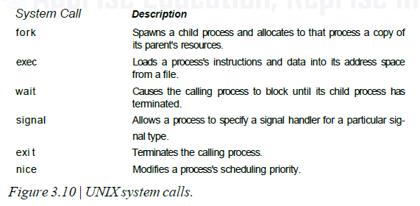
06_Case Study: UNIX Processes (2/2)
UNIX Process

